Slide 1
FILTERING OF ACOUSTIC INFORMATION FROM AERO-OPTICAL MEASUREMENTS
Brian Catron

Slide 2
Contents
Basic Aero-Optics
Optical-Acoustic Coupling
Multidimensional Spectral Estimation
Filtering of Optical Wavefronts
Conclusions and Recommendations

Slide 3
Basic Aero-Optics

Slide 4
Farfield Performance
An optical system’s farfield performance is affected by three main components
Diffraction
Nearfield Disturbances
Distributed Disturbances

Slide 5
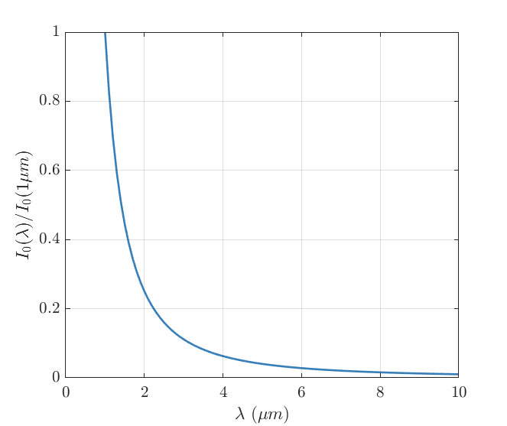
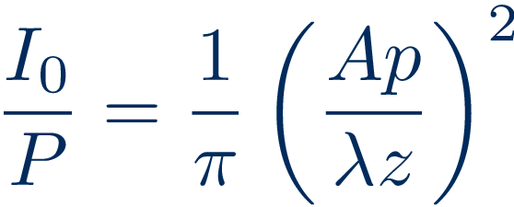
Diffraction
A perfect optical system will have degradation due to diffraction
Notes:
Equation 1.2 - \frac{I_0}{P} = \frac{1}{\pi}\left(\frac{Ap}{\lambda z}\right)^2

Slide 6
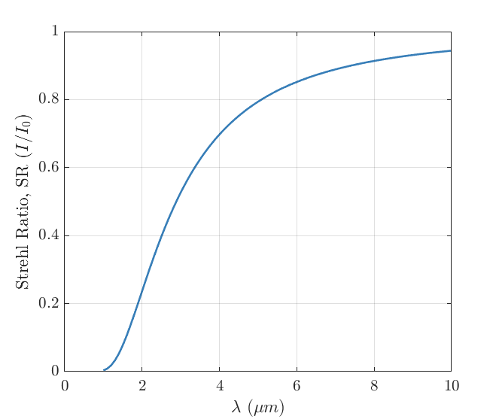
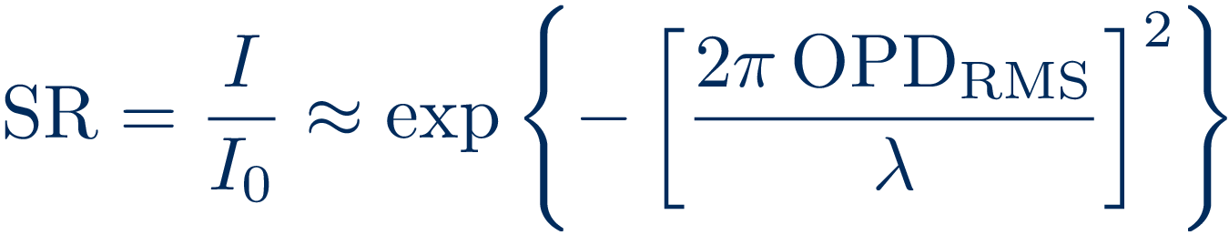
Nearfield Disturbances
First order estimate of the farfield performance due to nearfield disturbances
Notes:
Equation 1.1 and 1.3 - \sr = \frac{I}{I_0} \approx \exp\left\{-\left[\frac{2\pi \opdrms}{\lambda}\right]^2\right\}

Slide 7
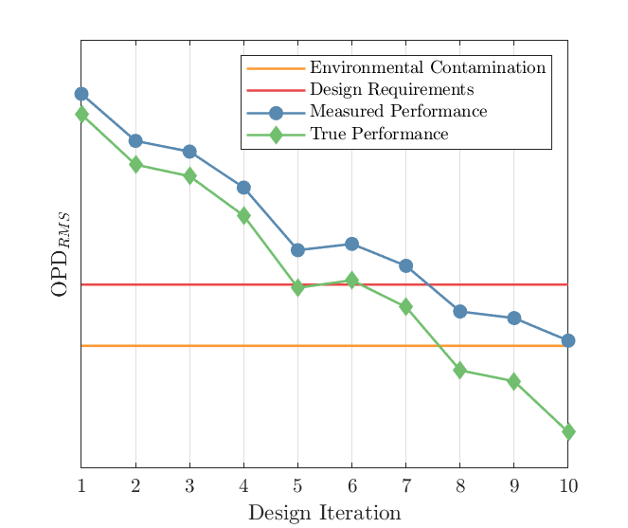
Future System Development
As the future airborne directed-energy systems are developed the environmental contamination of the test facility must be accounted for
Notes:
Equation 1.4 - \opdrms_{TOTAL}^2 = \opdrms_{MODEL}^2+\opdrms_{ENVIRONMENT}^2

Slide 8
Optical-Acoustic Coupling

Slide 9
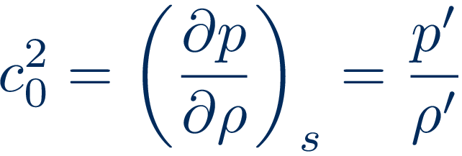
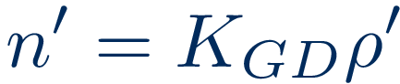
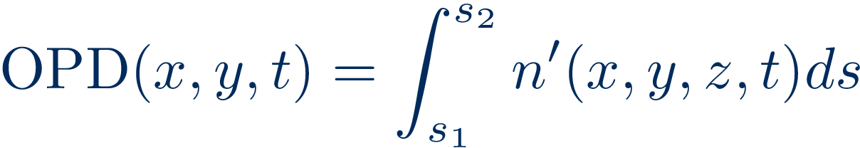
Sound to Index-of-Refraction
The definition of the speed of sound gives the relationship between pressure and density fluctuations in an acoustic wave
These density fluctuations can be related to index-of-refraction fluctuations via the Gladstone-Dale constant
Integrating over a vector passing through a fluctuating index-of-refraction field results in the optical path deference
Notes:
Equation 3.2 - c_0^2 = \left(\frac{\partial p}{\partial \rho}\right)_s=\frac{p'}{\rho'}
Equation 2.5 - n'=K_{GD}\rho‘
Equation 2.8 - \opd(x,y,t) = \int^{s_2}_{s_1} n'(x,y,z,t)ds

Slide 10
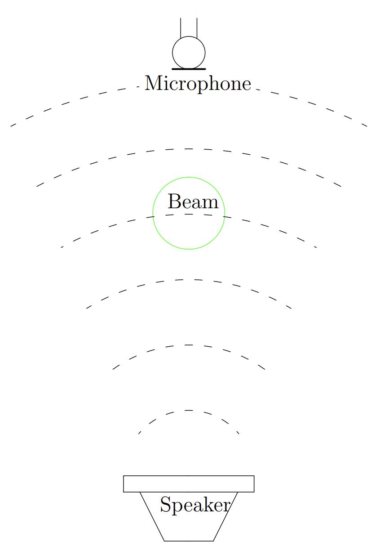
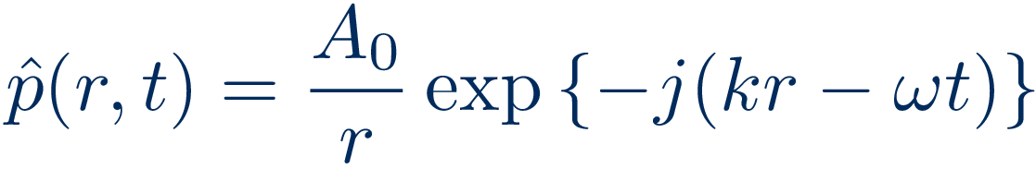
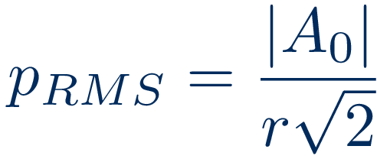
Spherical Wave
The acoustic field from a speaker can be assumed to be a spherical wave emanating from a pulsating point
The RMS pressure at any given point
Notes:
Equation 3.12 – \hat{p}(r,t) = \frac{A_0}{r}\exp\left\{-j(kr-\omega t)\right\}
Equation 3.13 – p_{RMS} = \frac{|A_0|}{r\sqrt{2}}
Figure 3.7

Slide 11
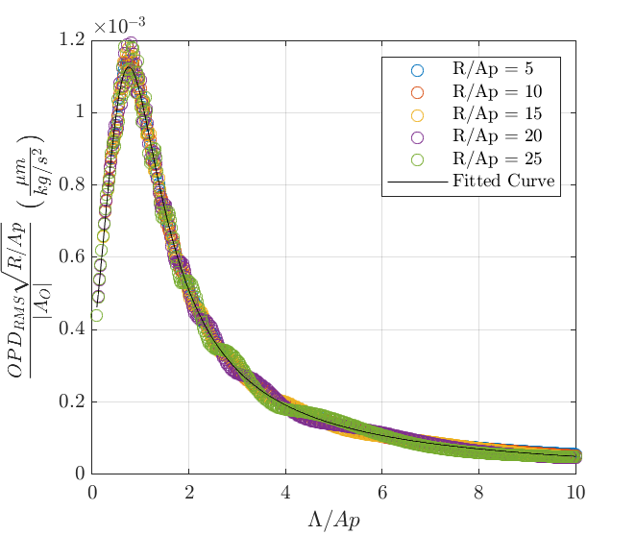
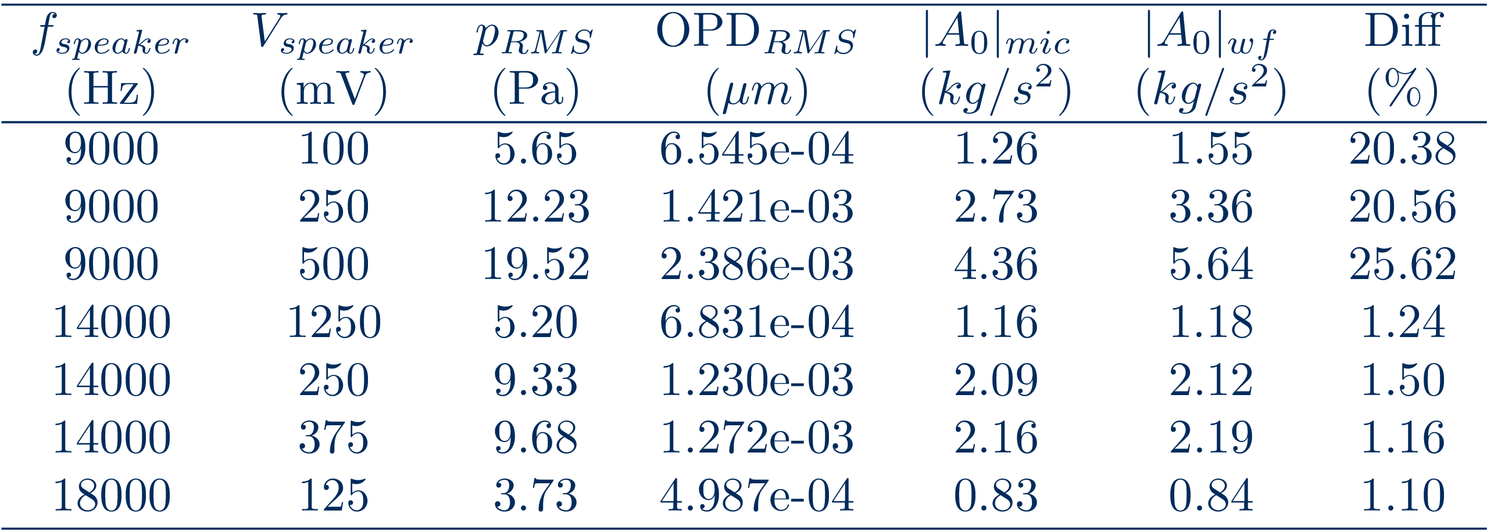
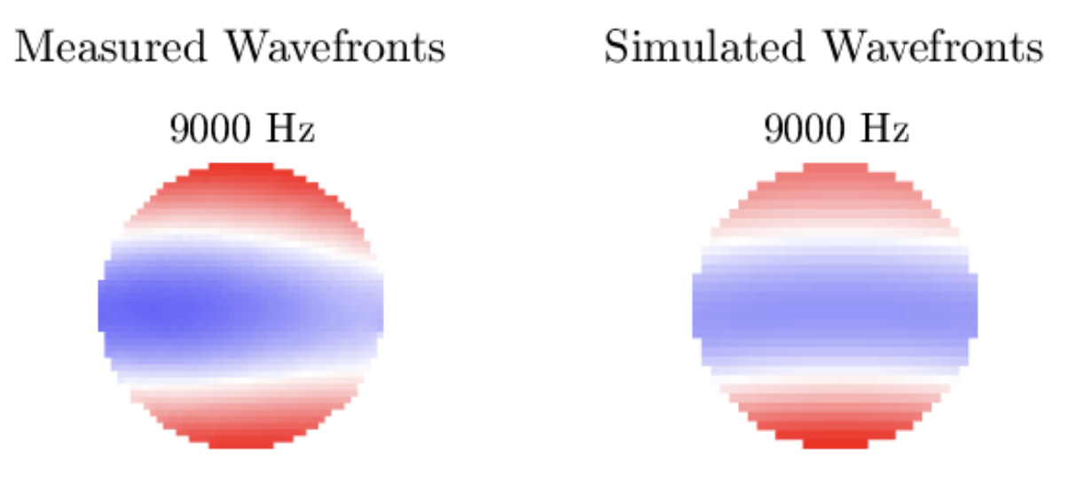
OPD_{RMS} to A₀
Notes:
Figure 3.6
Table 3.2
Figure 3.8

Slide 12
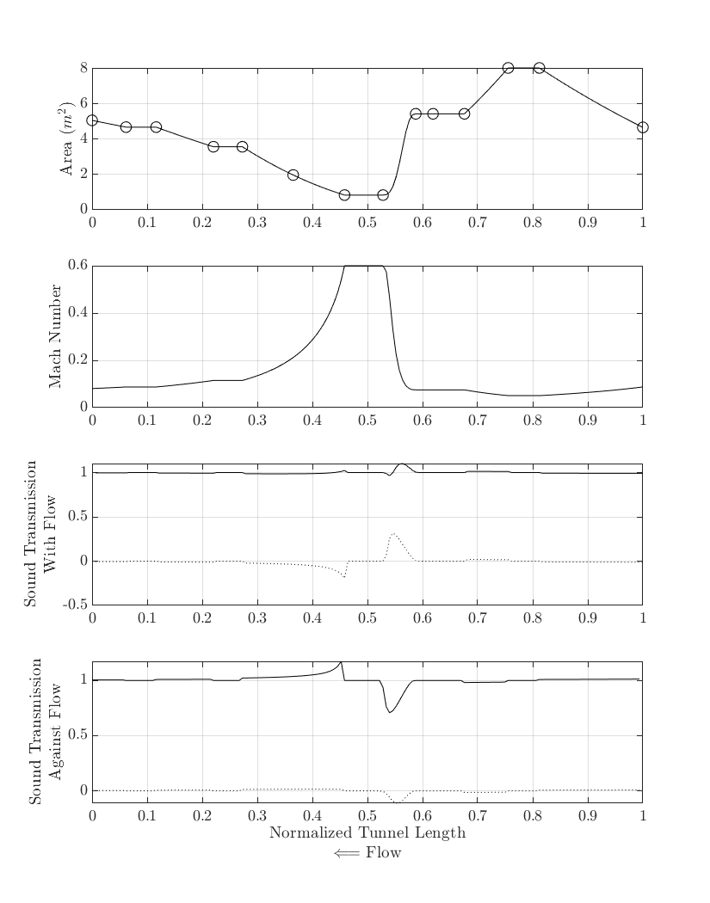
Wind Tunnel Fan Noise
Mode Marching Method to follow acoustic duct modes originating from the fan and passing into the test section
A quasi-1D model of the Whitefield M=0.6 tunnel was used
Transmission and reflection ratios were estimated through the tunnel
Notes:
Figure 3.11

Slide 13
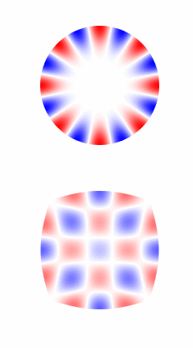
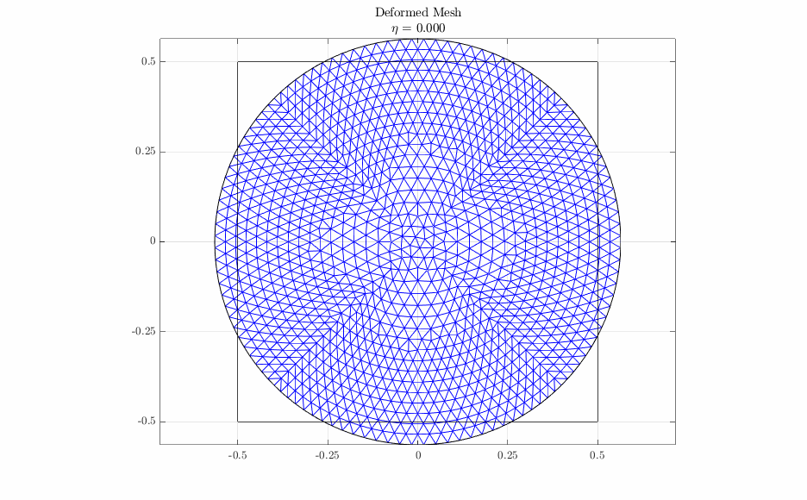
Round to Square Transition
A deformable mesh was used to allow for a 1-to-1 mapping of all points from one location to the next
Notes:
~Figure 3.9
~Figure 3.12

Slide 14
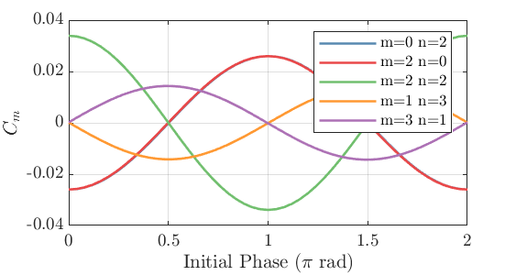
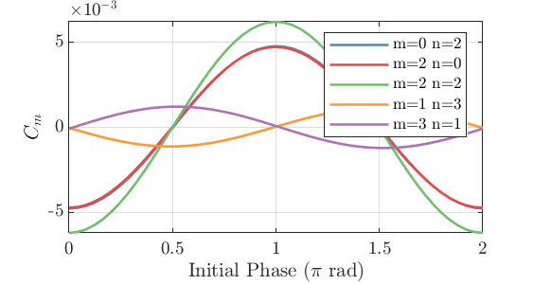
Test Section Acoustic Field
An empty test section is comprised of 5 duct modes due to the tunnel fan
The upstream traveling acoustic modes are an order-or-magnitude greater amplitude than the downstream traveling
Upstream Traveling
Downstream Traveling
Notes:
Figure 3.14
Figure 3.15

Slide 15
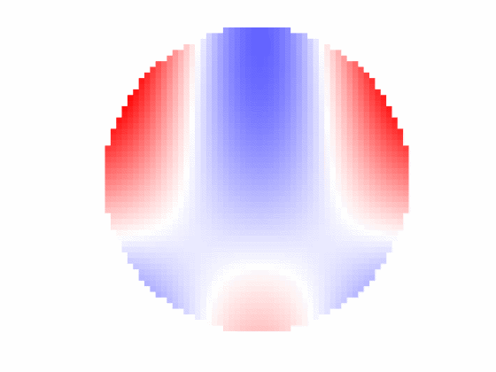
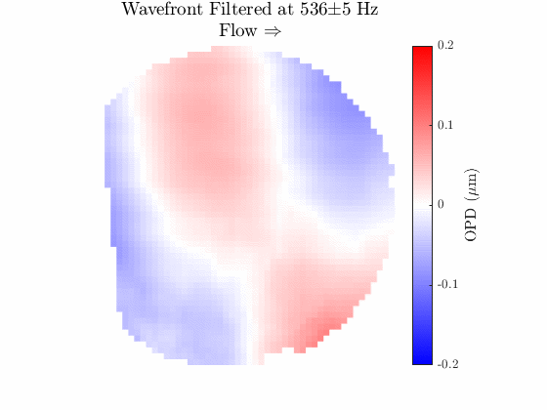
Comparison to Measured Data
Simulated Wavefront
Measured Wavefront

Slide 16
Multidimensional Spectral Estimation

Slide 17
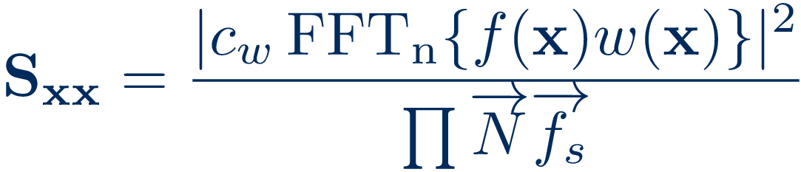
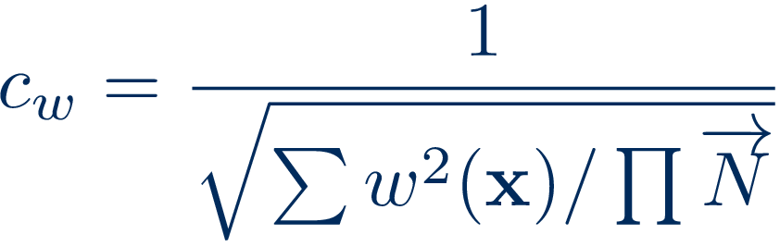
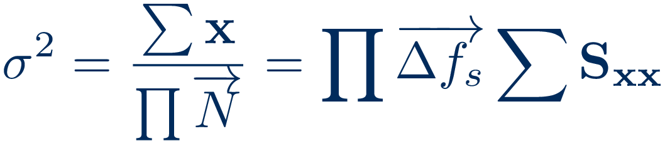
Power Spectra in N-Dimensions
Spectral information in time and space simultaneously
Windowing function was a temporal window multiplied by the spatial window
Spatial window used a modified Hann window
Notes:
Equation 4.11 – \mathbf{S_{xx}} =\frac{|c_w\fftn\{f(\mathbf{x}) w(\mathbf{x})\}|^2}{\prod{\overrightarrow{N}\overrightarrow{f_s}}}
Equation 4.12 – c_w = \frac{1}{\sqrt{\sum w^2(\mathbf{x})/\prod{\overrightarrow{N}}}}
Equation 4.13 – \sigma^2=\frac{\sum\mathbf{x}}{\prod{\overrightarrow{N}}} = \prod{\overrightarrow{\Delta f_s}}\sum\mathbf{S_{xx}}

Slide 18
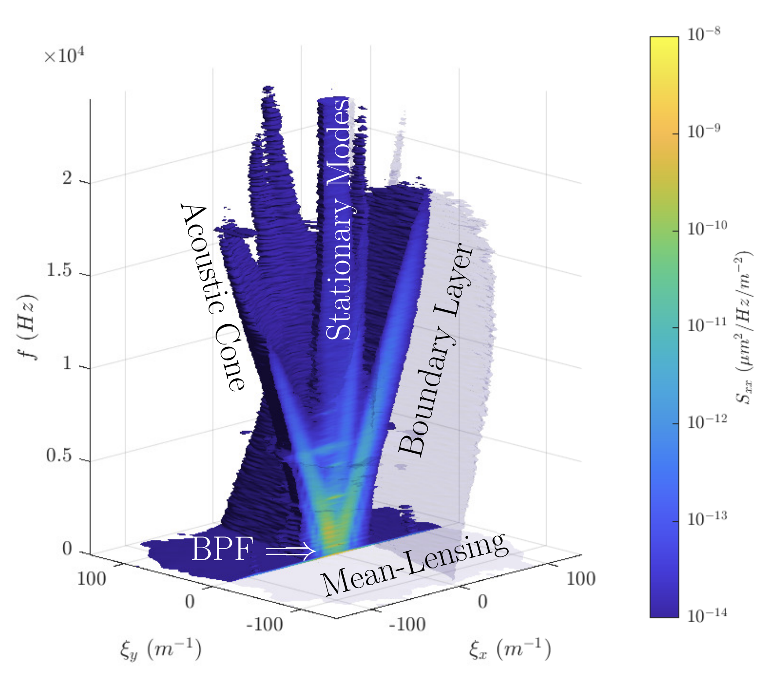
Cut Isosurface
Optical disturbance structures become evident
The narrow band temporal signals have a significant broad band spatial signals

Slide 19
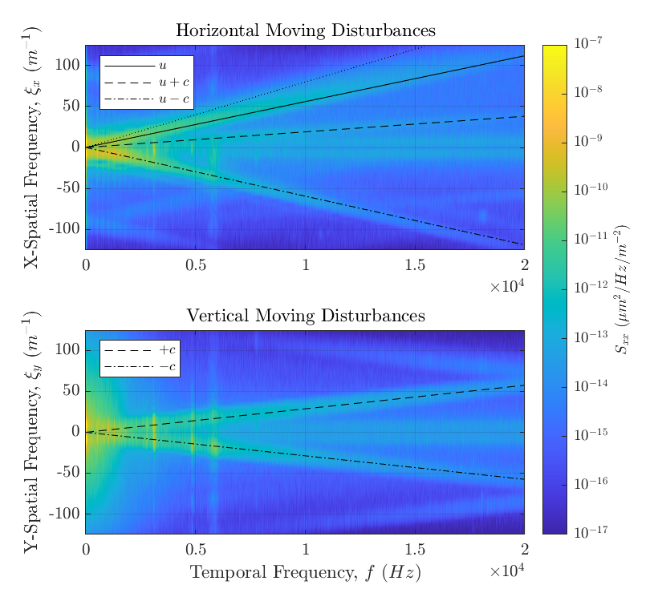
Plane Waves moving in X & Y
Disturbances move at the characteristic velocities: u, u±c
The slope of the lines are 1/v
Notes:
Figure 4.4

Slide 20
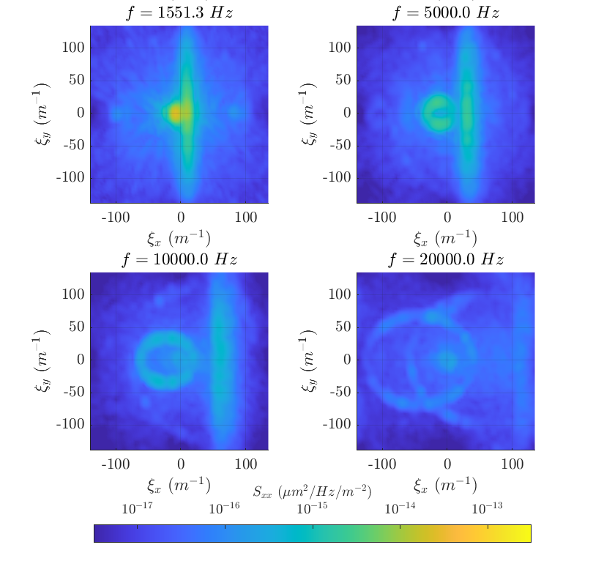
Slices in Frequency
Boundary Layer is rotated slightly counter-clockwise
The boundary layer signal has a sharp drop in power at u
The acoustic signal has some noticeable signal aliasing
Notes:
Figure 4.10

Slide 21
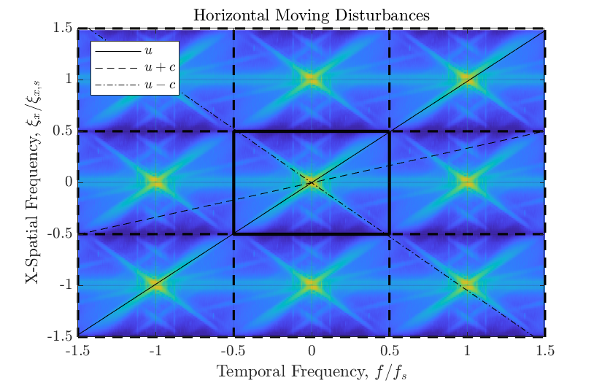

Signal Aliasing
Tiling the spectrum can help identify aliased signal
Sample velocity, , needs to be sufficiently different from a measured velocity to identify aliasing

Slide 22
Wavefront Filtering

Slide 23
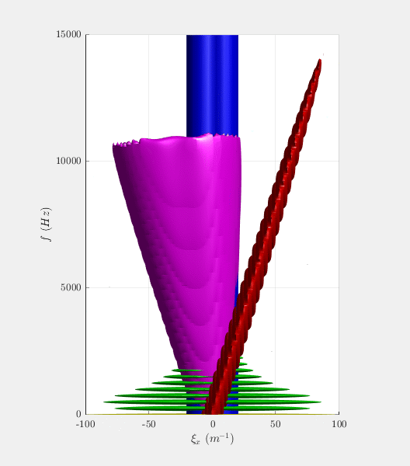
Synthetic Wavefront & Basic Filtering
For testing the performance of various filters a fully known signal needed to be generated
Two synthetic wavefronts were created, a BL only one and one with all disturbances
Filters are applied in spectral space and converted back to physical space
Notes:
Equation 6.1 – f_F(\mathbf{x}) = \real\left(\ifftn[H(j\mathbf{\omega})\fftn\{\mathbf{x}\}]\right)

Slide 24
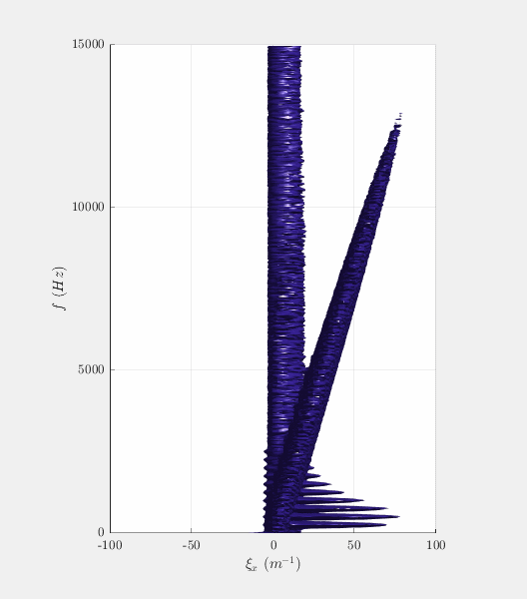
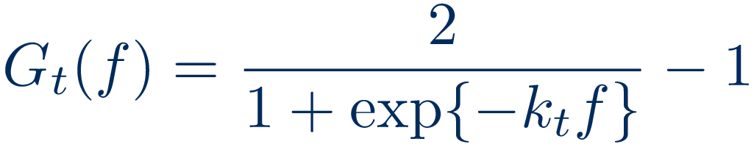
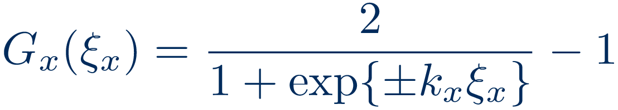
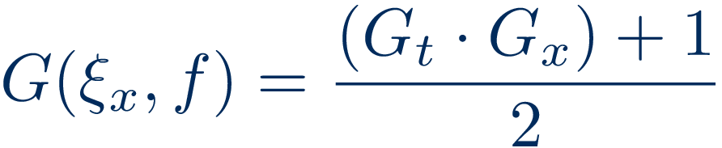
Upstream/Downstream Filter
Filter removes all of the signal that is traveling in a given direction
Can remove a significant portion of the acoustic signal
Notes:
Equation 6.5 –
Equation 6.6 –
Equation 6.7 –

Slide 25
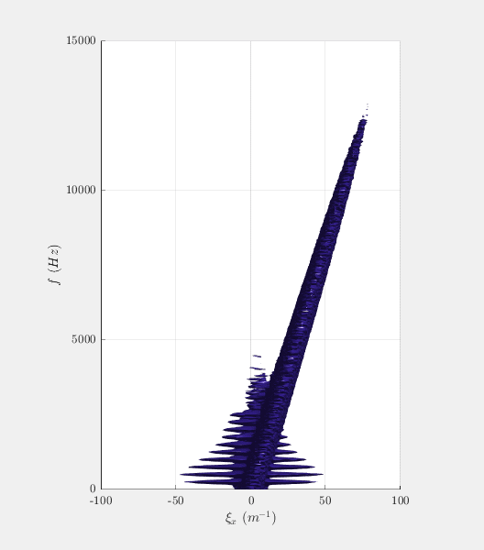
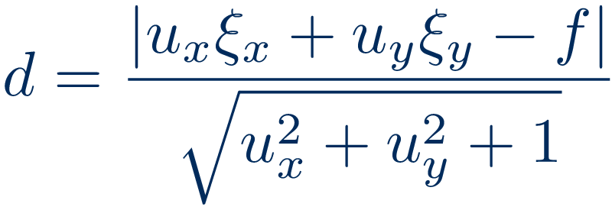
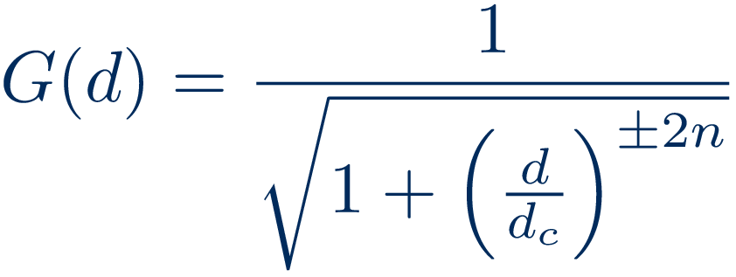
Velocity Filter
Low-pass filter based on the distance of a point in spectral space to the plane representing the velocity
Can also be used to measure the disturbance velocity
Notes:
Equation 6.8 –
Equation 6.9 –

Slide 26
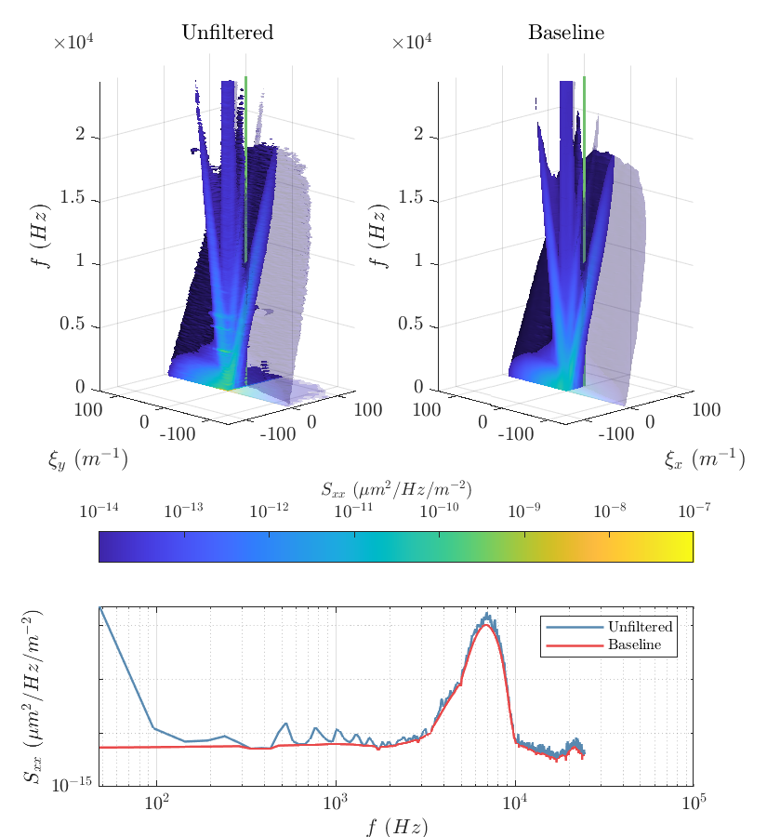
Baseline Filter
Filter algorithm developed for analysis of Ramen spectra
Applied along f at each ξ bin
The more narrow a signal spike the more likely it will be filtered out
b: baseline spectrum m: measured spectrum
H. G. Schulze, R. B. Foist, K. Okuda, A. Ivanov, and R. F. B. Turner. A small-window moving average-based fully automated baseline estimation method for raman spectra. Applied Spectroscopy, 66(7):757–764, 2012. doi: 10.1366/ 11-06550.
Notes:
Equation 6.12 –
Figure 6.7 –
x: underlying signal vector
p: instrumental blurring function
n: measurement noise

Slide 27
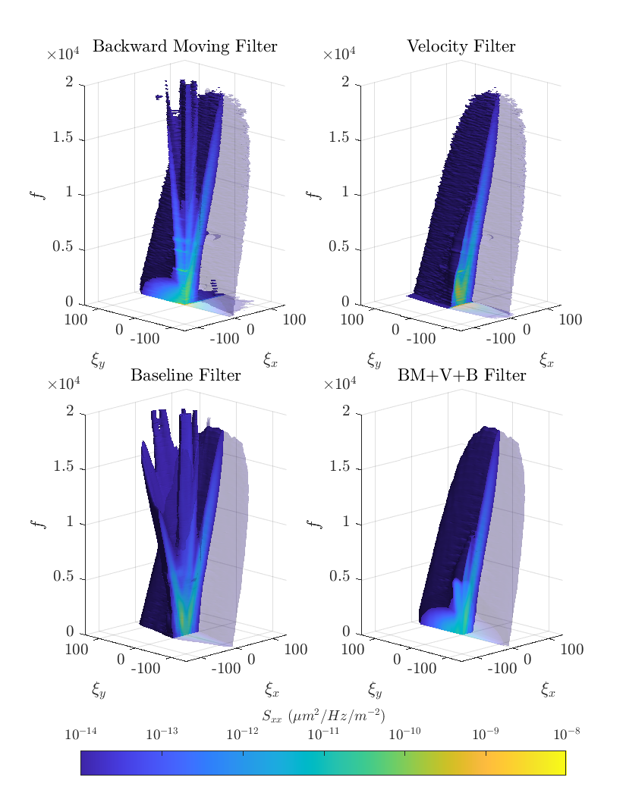
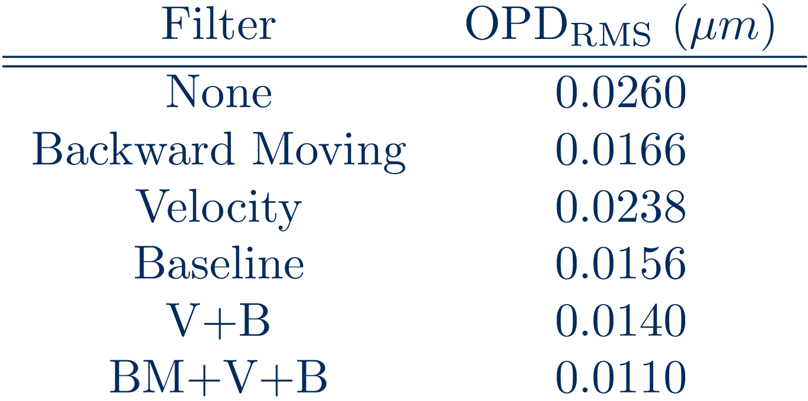
Filter Combinations
Combined filters take advantage of the strengths of the parent filters
Estimated BL OPD_{RMS}: 0.0142µm
Notes:
Figure 7.3
Table 7.2

Slide 28
Conclusion and Recommendations

Slide 29
Questions

Slide 30
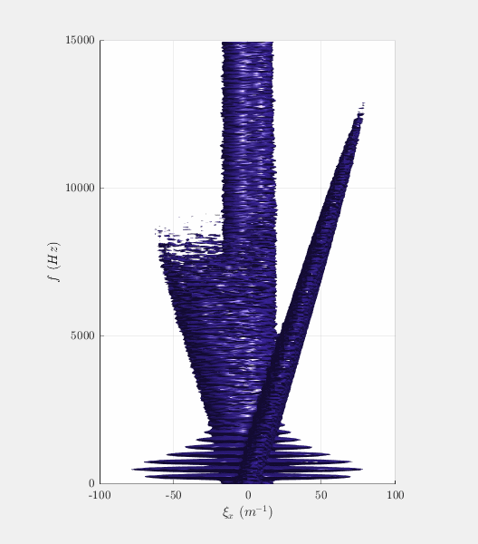
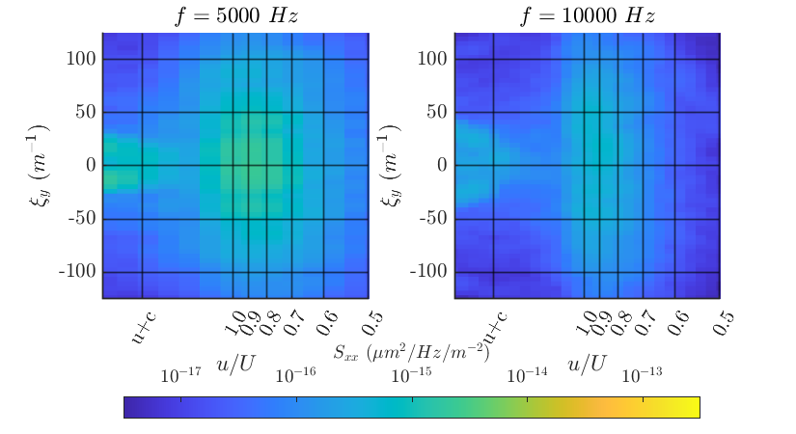

Slide 31
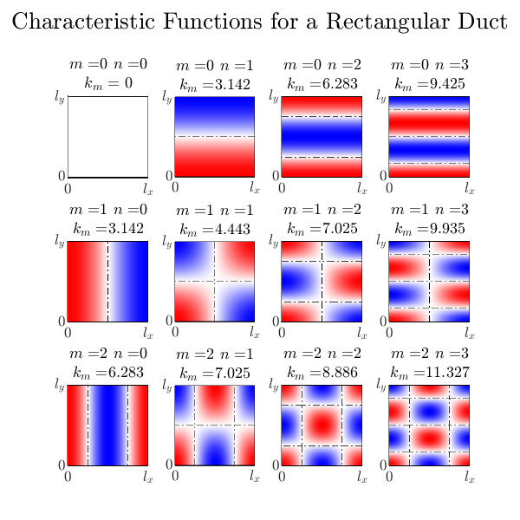
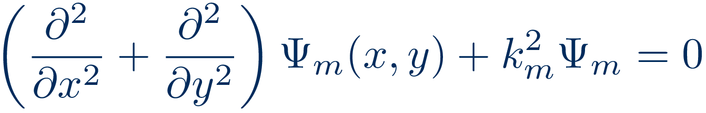
Acoustic Duct Modes
The mode shapes are eigen-function solutions of
Known analytical solutions for circular and rectangular ducts but arbitrary shapes must be numerically solved

Slide 32
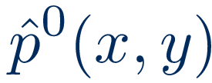
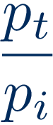
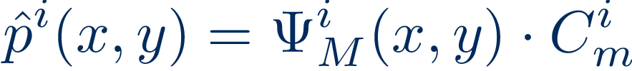
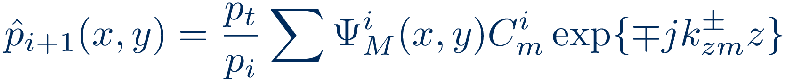
Mode-Marching Method
Starting Acoustic Pressure Disturbance
Modal Best Fit
Transmitted Pressure Ratio [1]
March Modes Forward
[1] Powell, “Propagation of a Pressure Pulse in a Compressible Flow,” The Journal of the Acoustical Society of America, Vol. 31,No. 11, 1959, pp. 1527–1535. doi:10.1121/1.1907660.

